Slide 1
Setting up a server in AWS
Presented By,
Mohammed Nauman Siddique

Slide 2
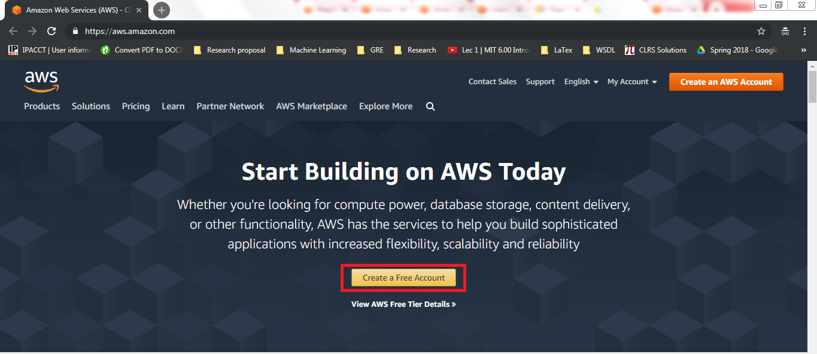
Create an AWS Account

Slide 3
Open Amazon EC2 Console
https://console.aws.amazon.com/ec2/

Slide 4
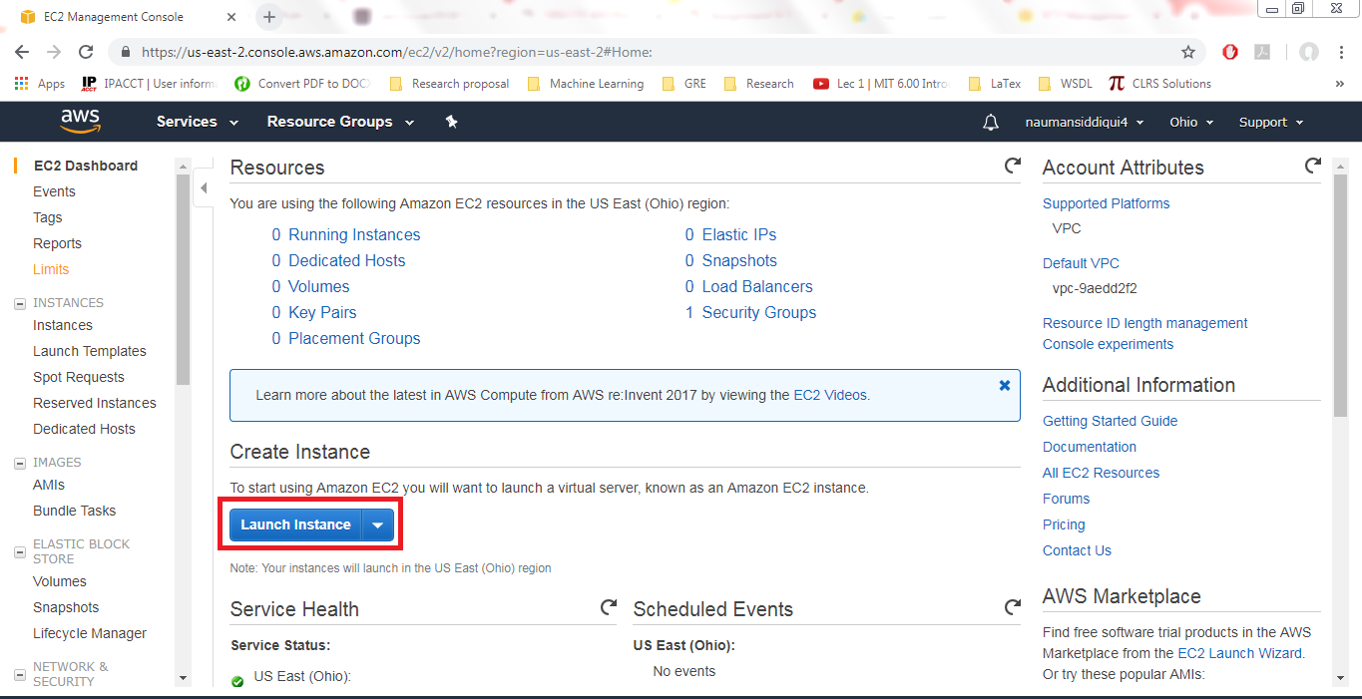
Launch Instance

Slide 5
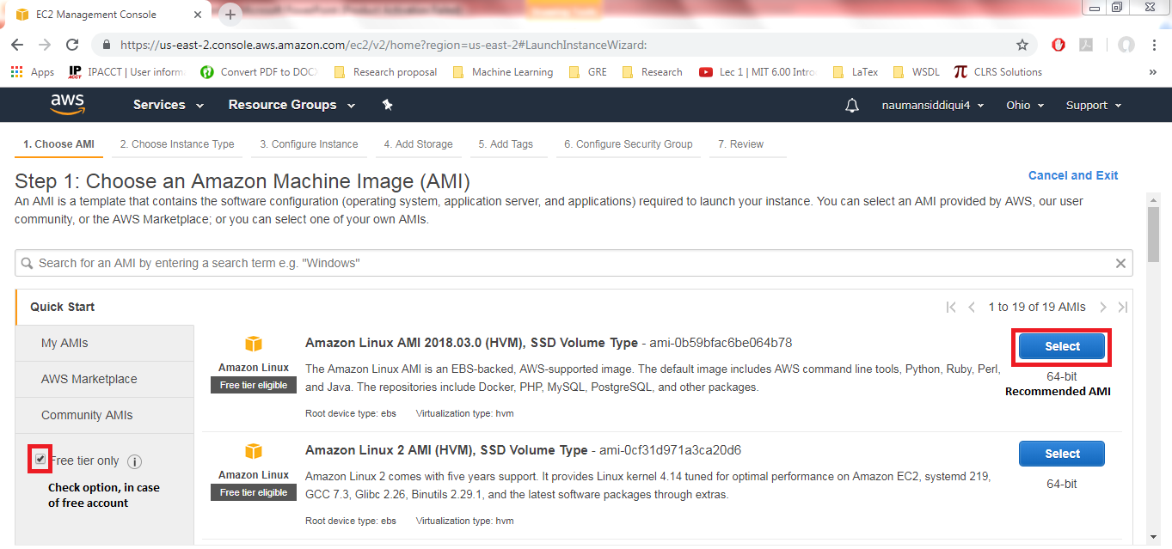
Choose Amazon Machine Image

Slide 6
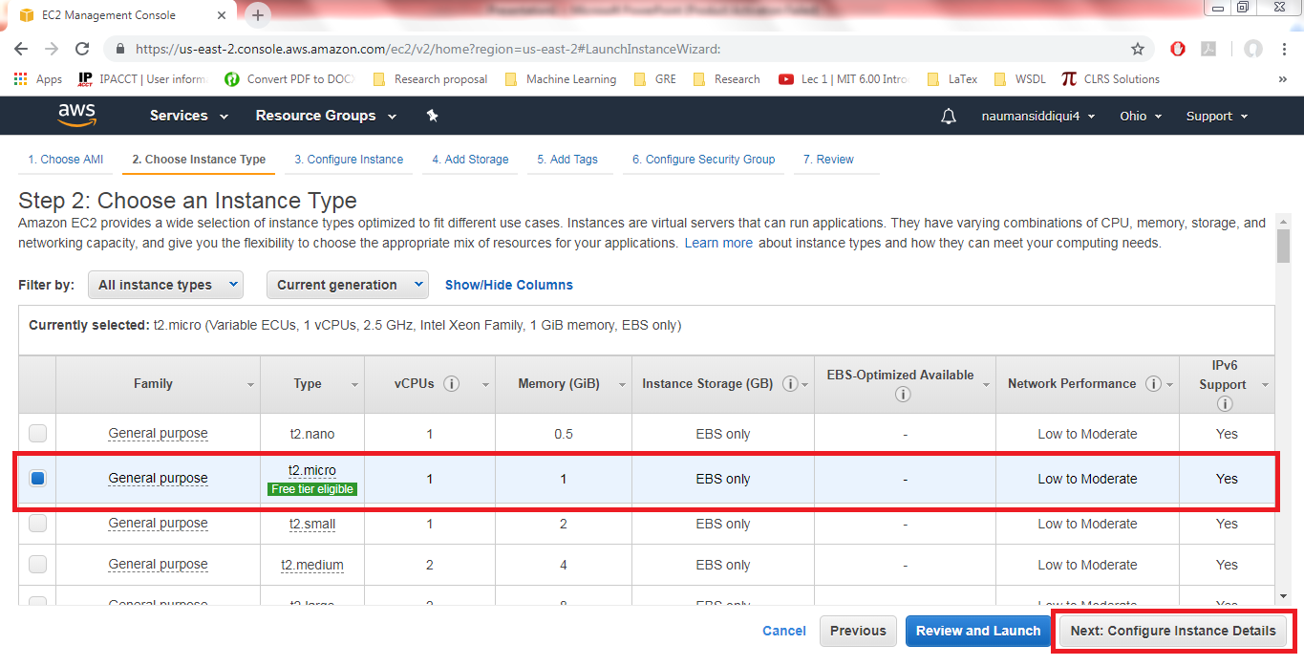
Choose Instance Type

Slide 7
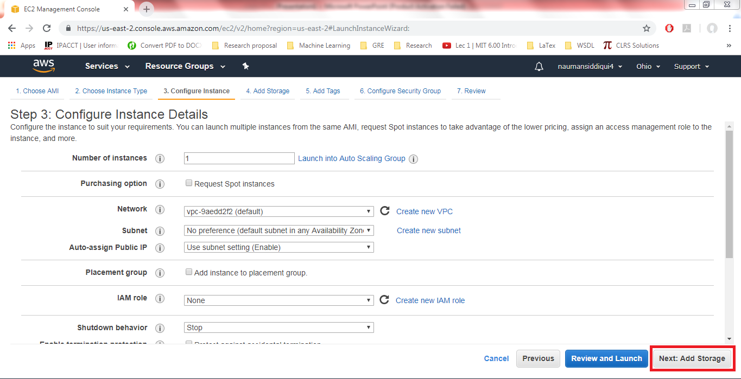
Configure Instance

Slide 8
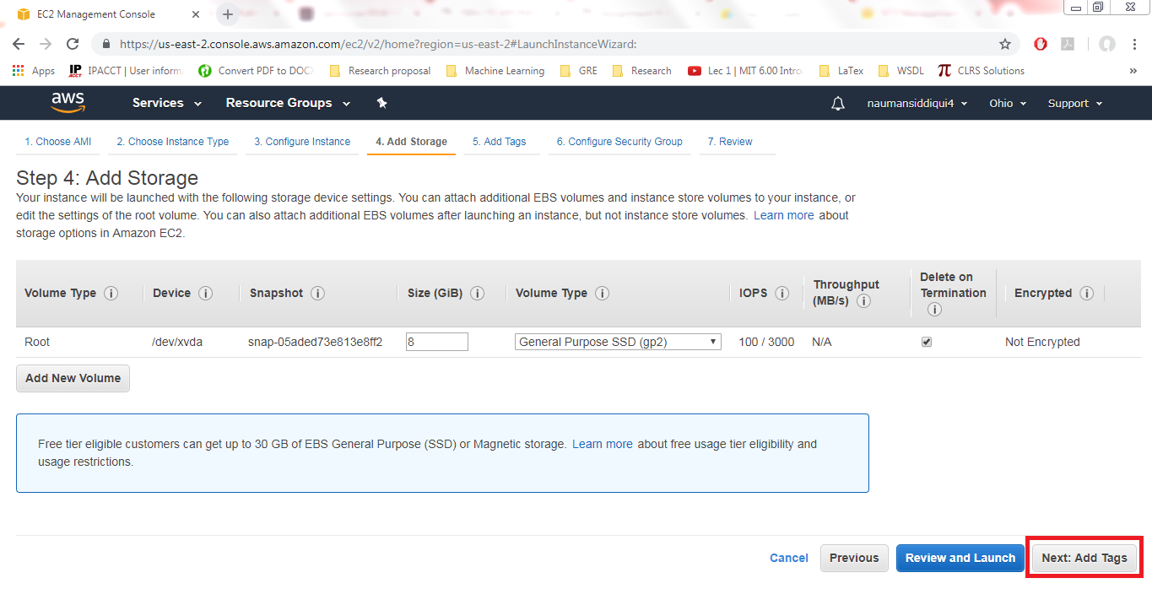
Add Storage

Slide 9
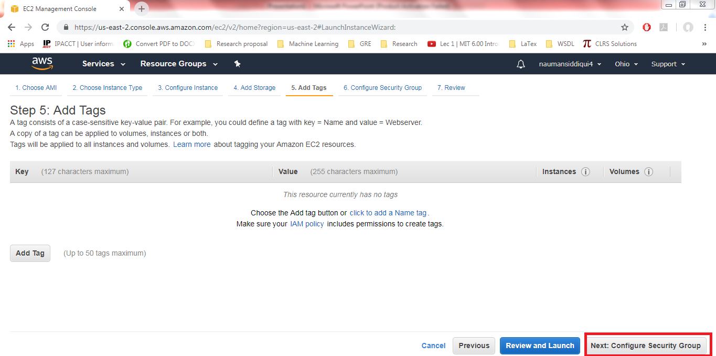
Add Tags

Slide 10
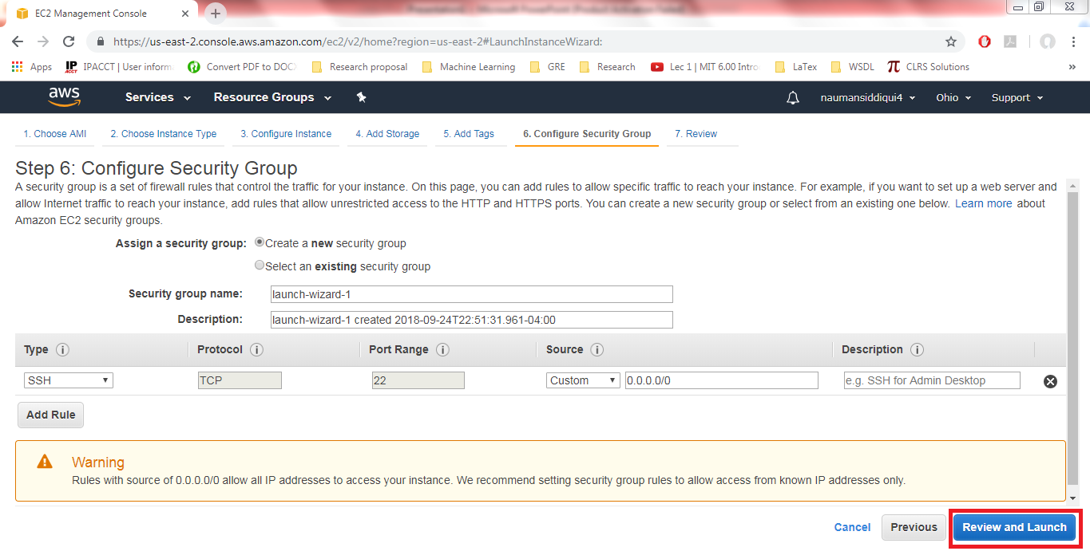
Configure Security Group

Slide 11
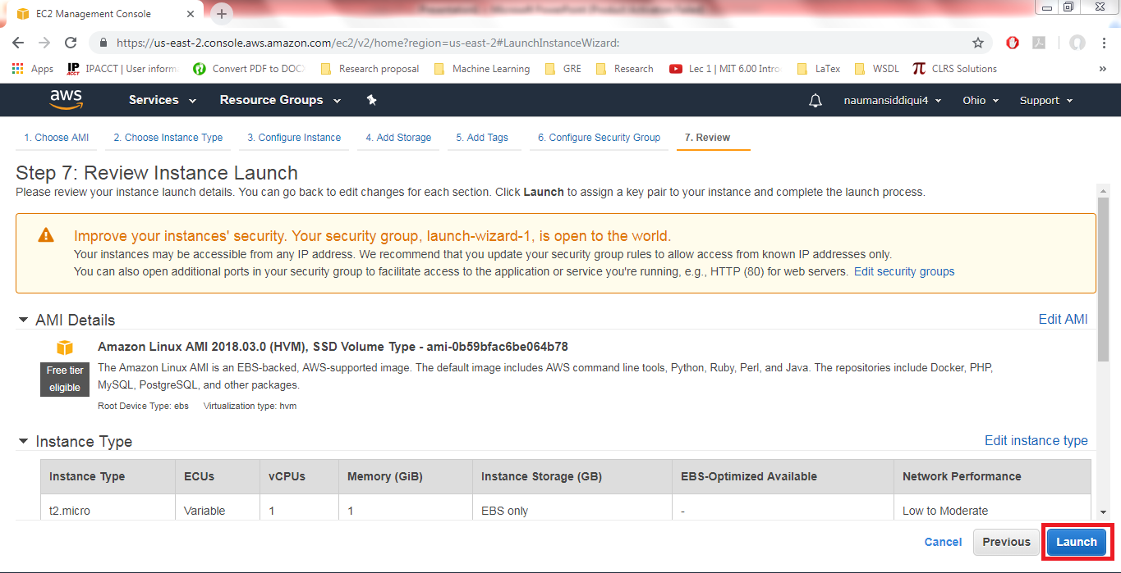
Review Instance Launch Settings

Slide 12
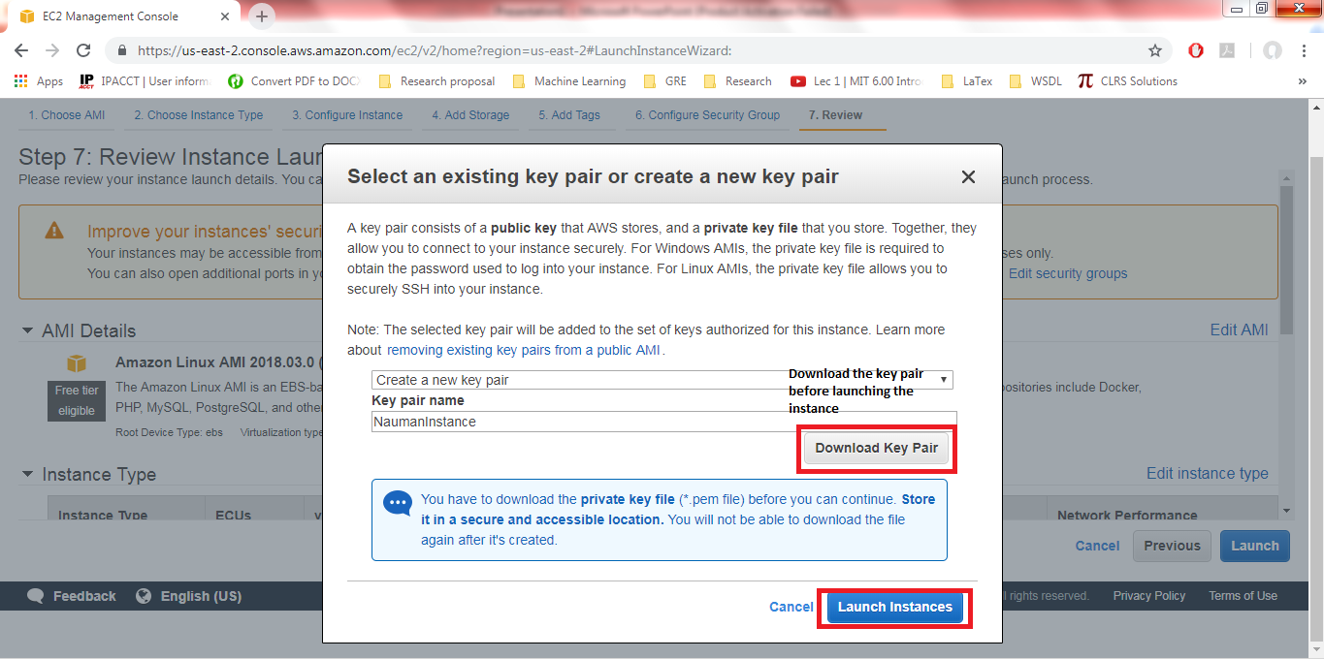
Key Pair Download

Slide 13
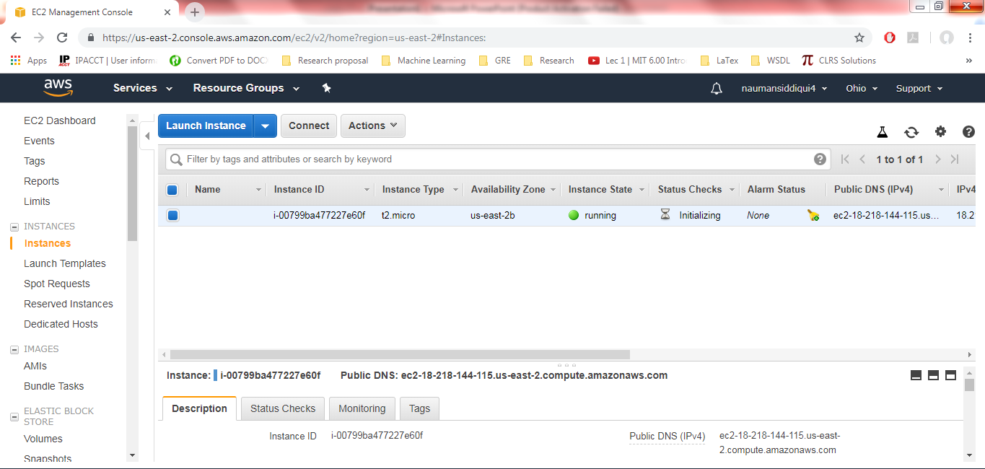
Instance Running

Slide 14
Reference
https://docs.aws.amazon.com/efs/latest/ug/gs-step-one-create-ec2-resources.html

